Slide 1


Big Data Analytics
Lecture: 3-4
Md. Manowarul Islam
Assistant Professor, Dept. of CSE
Jagannath University

Slide 2
Chapter 2: Data Preprocessing
Why preprocess the data?
Descriptive data summarization
Data cleaning
Data integration and transformation
Data reduction
Discretization and concept hierarchy generation
Summary

Slide 3
Why do we need data analytics?
Really huge amounts of complex data generated from multiple sources and interconnected in different ways
  Scientific data from different disciplines
  Huge text collections
  Transaction data
  Behavioral data
  Networked data
  All these types of data can be combined in many ways
We need to analyze this data to extract knowledge
  Knowledge can be used for commercial or scientific purposes.
  Our solutions should scale to the size of the data

Slide 4
The data analysis pipeline
Mining is not the only step in the analysis process
Preprocessing: real data is noisy, incomplete and inconsistent. Data cleaning is required to make sense of the data
  Techniques: Sampling, Dimensionality Reduction, Feature selection.
  A dirty work, but it is often the most important step for the analysis.
Post-Processing: Make the data actionable and useful to the user
  Statistical analysis of importance
  Visualization.
  Pre- and Post-processing are often data mining tasks as well
Data Preprocessing
Data Mining
Result
Post-processing

Slide 5
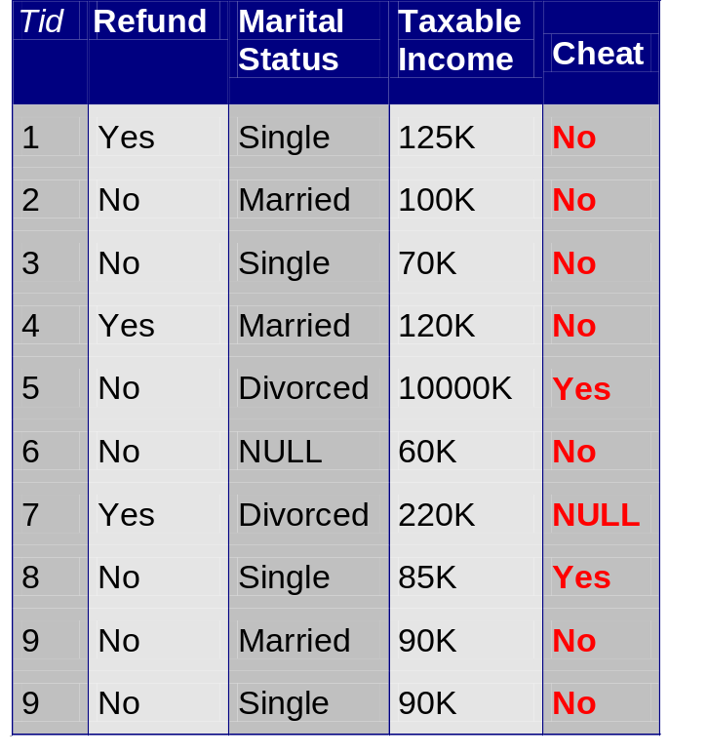
Data Quality
Examples of data quality problems:
  Noise and outliers
  Missing values
  Duplicate data
A mistake or a millionaire?
Missing values
Inconsistent duplicate entries

Slide 6
Why Data Preprocessing?
Data in the real world is dirty
  incomplete: lacking attribute values, lacking certain attributes of interest, or containing only aggregate data
    e.g., occupation=“ ”
  noisy: containing errors or outliers
    e.g., Salary=“-10”
  inconsistent: containing discrepancies in codes or names
    e.g., Age=“42” Birthday=“03/07/1997”
    e.g., Was rating “1,2,3”, now rating “A, B, C”
    e.g., discrepancy between duplicate records

Slide 7
Why Is Data Dirty?
Incomplete data may come from
  “Not applicable” data value when collected
  Different considerations between the time when the data was collected and when it is analyzed.
  Human/hardware/software problems
Noisy data (incorrect values) may come from
  Faulty data collection instruments
  Human or computer error at data entry
  Errors in data transmission
Inconsistent data may come from
  Different data sources
  Functional dependency violation (e.g., modify some linked data)
Duplicate records also need data cleaning

Slide 8
Why Is Data Preprocessing Important?
No quality data, no quality mining results!
  Quality decisions must be based on quality data
    e.g., duplicate or missing data may cause incorrect or even misleading statistics.
  Data warehouse needs consistent integration of quality data
Data extraction, cleaning, and transformation comprises the majority of the work of building a data warehouse

Slide 9
Major Tasks in Data Preprocessing
Data cleaning
  Fill in missing values, smooth noisy data, identify or remove outliers, and resolve inconsistencies
Data integration
  Integration of multiple databases, data cubes, or files
Data transformation
  Normalization and aggregation
Data reduction
  Obtains reduced representation in volume but produces the same or similar analytical results
Data discretization
  Part of data reduction but with particular importance, especially for numerical data

Slide 10

Forms of Data Preprocessing

Slide 11
Chapter 2: Data Preprocessing
Why preprocess the data?
Descriptive data summarization
Data cleaning
Data integration and transformation
Data reduction
Discretization and concept hierarchy generation
Summary

Slide 12
Mining Data Descriptive Characteristics
Motivation
  To better understand the data: central tendency, variation and spread
Data dispersion characteristics
  median, max, min, quantiles, outliers, variance, etc.
Numerical dimensions correspond to sorted intervals
  Data dispersion: analyzed with multiple granularities of precision
  Boxplot or quantile analysis on sorted intervals
Dispersion analysis on computed measures
  Folding measures into numerical dimensions
  Boxplot or quantile analysis on the transformed cube

Slide 13
Central Tendency
A measure of central tendency is a value at the center or middle of a data set.
  Mean, median, mode

Slide 14
Terminology
Population
  A collection of items of interest in research
  A complete set of things
  A group that you wish to generalize your research to
  An example – All the trees in Battle Park
Sample
  A subset of a population
  The size smaller than the size of a population
  An example – 100 trees randomly selected from Battle Park

Slide 15
Sample vs. Population
Population
Sample

Slide 16
Measures of Central Tendency – Mean
Mean – Most commonly used measure of central tendency
Average of all observations
The sum of all the scores divided by the number of scores
Note: Assuming that each observation is equally significant

Slide 17
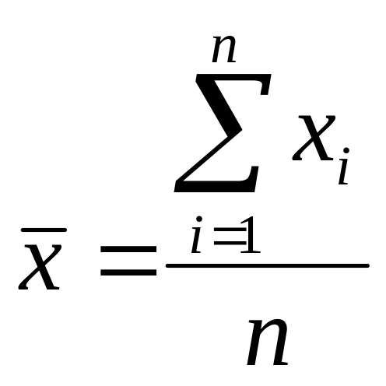
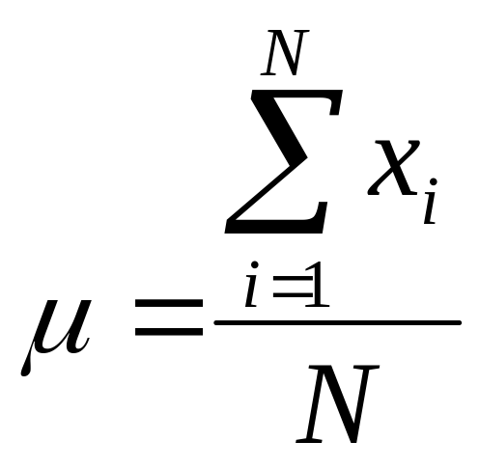
Measures of Central Tendency – Mean
Sample mean:
Population mean:

Slide 18
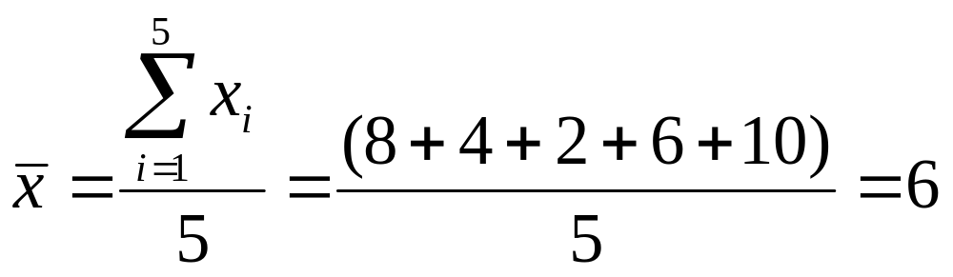
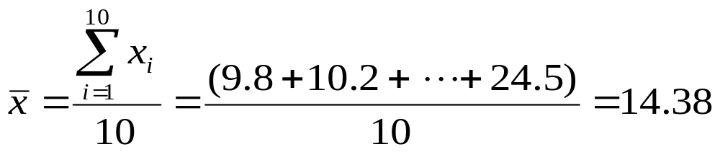
Measures of Central Tendency – Mean
Example I
  - Data: 8, 4, 2, 6, 10
Example II
  Sample: 10 trees randomly selected from Battle Park
  Diameter (inches):
    9.8, 10.2, 10.1, 14.5, 17.5, 13.9, 20.0, 15.5, 7.8, 24.5

Slide 19

Weighted Mean
We can also calculate a weighted mean using some weighting factor:
e.g. What is the average income of all people in cities A, B, and C:
City Avg. Income Population
A $23,000 100,000
B $20,000 50,000
C $25,000 150,000
Here, population is the weighting factor and the average income is the variable of interest

Slide 20
Measures of Central Tendency – Median
Median – This is the value of a variable such that half of the observations are above and half are below this value i.e. this value divides the distribution into two groups of equal size
When the number of observations is odd, the median is simply equal to the middle value
When the number of observations is even, we take the median to be the average of the two values in the middle of the distribution

Slide 21
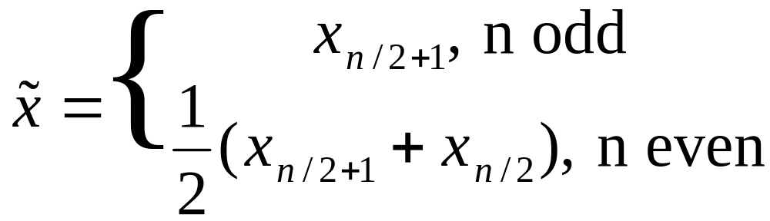
Measures of Central Tendency – Median

Slide 22
Measures of Central Tendency – Median
Example I
  Data: 8, 4, 2, 6, 10 (mean: 6)
2, 4, 6, 8, 10
median: 6
Example II
  Sample: 10 trees randomly selected from Battle Park
  Diameter (inches):
    9.8, 10.2, 10.1, 14.5, 17.5, 13.9, 20.0, 15.5, 7.8, 24.5
    (mean: 14.38)
7.8, 9.8, 10.1, 10.2, 13.9, 14.5, 15.5, 17.5, 20.0, 24.5
median: (13.9 + 14.5) / 2 = 14.2

Slide 23

Measures of Central Tendency – Median
For calculation of median in a continuous frequency distribution the following formula will be employed. Algebraically,
L1=lower bound of median class
N = total population
f= frequency of median class
cf= Cumulative frequencies of previous class
i = class interval

Slide 24
Measures of Central Tendency – Median
Age Group | Frequency of Median class(f) | Cumulative frequencies(cf)
0-20 | 15 | 15
20-40 | 32 | 47
40-60 | 54 | 101
60-80 | 30 | 131
80-100 | 19 | 150
Total | 150

Slide 25
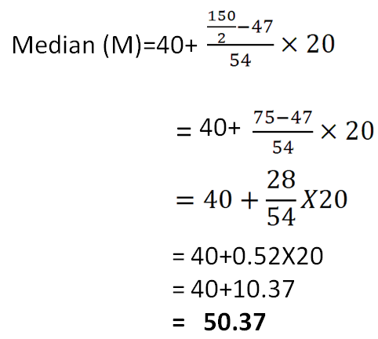
Measures of Central Tendency – Median
Find the value of N/2
Find cf for median class
Age Group | Frequency of Median class(f) | Cumulative frequencies (cf)
0-20 | 15 | 15
20-40 | 32 | 47
40-60 | 54 | 101
60-80 | 30 | 131
80-100 | 19 | 150
Total | 150
L1=lower bound of median class
N = total population
f= frequency of median class
cf= Cumulative frequencies of previous class
i = class interval

Slide 26
Measures of Central Tendency – Mode
Mode – Mode is the most frequent value or score in the distribution.
It is defined as that value of the item in a series
Example I
80 87 89 93 93 96 97 98 102 103 105 106 109 109 109 110 111 115 119 120 127 128 131 131 140 162
mode!!

Slide 27

Measures of Central Tendency – Mode
The exact value of mode can be obtained by the following formula.
L1=lower bound of modal class
f1= frequency of modal class
f0= frequency of previous class
f2= frequency of next class
i = class interval

Slide 28
Measures of Central Tendency – Mode
Monthly rent (Rs) | Number of Libraries (f)
500-1000 | 5
1000-1500 | 10
1500-2000 | 8
2000-2500 | 16
2500-3000 | 14
3000 & Above | 12
Total | 65

Slide 29
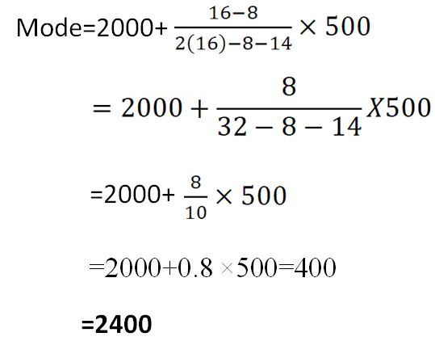
Measures of Central Tendency – Mode
Monthly rent (Rs) | Number of Libraries (f)
500-1000 | 5
1000-1500 | 10
1500-2000 | 8
2000-2500 | 16
2500-3000 | 14
3000 & Above | 12
Total | 65
L1=lower bound of modal class
f1= frequency of modal class
f0= frequency of previous class
f2= frequency of next class
i = class interval

Slide 30
Measures of Central Tendency – Mode
  Value that occurs most frequently in the data
  Empirical formula:

Slide 31



Symmetric vs. Skewed Data
Median, mean and mode of symmetric, positively and negatively skewed data

Slide 32
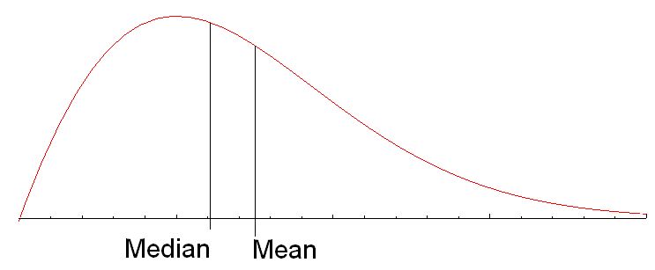
Data Skewed Right
Here we see that the data is skewed to the right and the position of the Mean is to the right of the Median.
  One may surmise that there is data that is tending to spread the data out at the high end, thereby affecting the value of the mean.

Slide 33
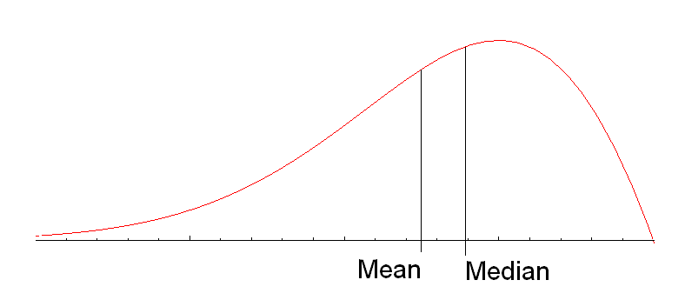
Data Skewed left
Here we see that the data is skewed to the left and the position of the Mean is to the left of the Median.
  One may surmise that there is data that is tending to spread the data out at the low end, thereby affecting the value of the mean.

Slide 34


Measuring the Dispersion of Data
Quartiles, outliers and boxplots
  Quartiles: Q₁ (25th percentile), Q₃ (75th percentile)
  Inter-quartile range: IQR = Q₃ – Q₁
  Five number summary: min, Q₁, M, Q₃, max
  Boxplot: ends of the box are the quartiles, median is marked, whiskers, and plot outlier individually
  Outlier: usually, a value higher/lower than 1.5 x IQR
Variance and standard deviation (sample: s, population: σ)
  Variance: (algebraic, scalable computation)
  Standard deviation s (or σ) is the square root of variance s² ⁽or σ²⁾

Slide 35
Summary Measures
Describing Data Numerically
Central Tendency
Quartiles
Variation
Shape
Arithmetic Mean
Range
Skewness
Median
Interquartile Range
Mode
Variance
Geometric Mean
Standard Deviation
Coefficient of Variation

Slide 36
Quartiles
Quartiles split the ranked data into 4 segments with an equal number of values per segment
25%
25%
25%
25%
Q1
Q2
Q3
The first quartile, Q₁, is the value for which 25% of the observations are smaller and 75% are larger
Q₂ is the same as the median (50% are smaller, 50% are larger)
Only 25% of the observations are greater than the third quartile

Slide 37
Quartiles
Find a quartile by determining the value in the appropriate position in the ranked data, where
First quartile position : Q₁ at (n+1)/4
Second quartile position : Q₂ at (n+1)/2 (median)
Third quartile position : Q₃ at 3(n+1)/4
where n is the number of observed values

Slide 38
Interquartile Range
Can eliminate some outlier problems by using the interquartile range
Eliminate some high- and low-valued observations and calculate the range from the remaining values
Interquartile range = 3rd quartile – 1st quartile
= Q₃ – Q₁

Slide 39
Quartiles
Example 1: Find the median and quartiles for the data below.
12, 6, 4, 9, 8, 4, 9, 8, 5, 9, 8, 10
Order the data
Q₁
Q₂
Q₃
4, 4, 5, 6, 8, 8, 8, 9, 9, 9, 10, 12
Lower Quartile = 5½
Upper Quartile = 9
Median = 8
Inter-Quartile Range = 9 - 5½ = 3½

Slide 40
Quartiles
Example 2: Find the median and quartiles for the data below.
6, 3, 9, 8, 4, 10, 8, 4, 15, 8, 10
Order the data
Q₁
Q₂
Q₃
3, 4, 4, 6, 8, 8, 8, 9, 10, 10, 15,
Lower Quartile = 4
Upper Quartile = 10
Median = 8
Inter-Quartile Range = 10 - 4 = 6

Slide 41
Range
Simplest measure of variation
Difference between the largest and the smallest observations:
Disadvantages = ignores distribution of data and sensitive to outliers
Range = X_{largest} – X_{smallest}

Slide 42

Boxplot Analysis
Five-number summary of a distribution:
  Minimum, Q1, M, Q3, Maximum
Boxplot
  Data is represented with a box
  The ends of the box are at the first and third quartiles, i.e., the height of the box is IRQ
  The median is marked by a line within the box
  Whiskers: two lines outside the box extend to Minimum and Maximum

Slide 43
Drawing a Box Plot
Example 1: Draw a Box plot for the data below
Q₁
Q₂
Q₃
4, 4, 5, 6, 8, 8, 8, 9, 9, 9, 10, 12
Lower Quartile = 5½
Upper Quartile = 9
Median = 8
4
5
6
7
8
9
10
11
12

Slide 44
Drawing a Box Plot
Example 2: Draw a Box plot for the data below
Q₁
Q₂
Q₃
3, 4, 4, 6, 8, 8, 8, 9, 10, 10, 15,
Lower Quartile = 4
Upper Quartile = 10
Median = 8
3
4
5
6
7
8
9
10
11
12
13
14
15

Slide 45
Drawing a Box Plot
Question: Stuart recorded the heights in cm of boys in his class as shown below. Draw a box plot for this data.
Q_{L}
Q₂
Q_{u}
137, 148, 155, 158, 165, 166, 166, 171, 171, 173, 175, 180, 184, 186, 186
Lower Quartile = 158
Upper Quartile = 180
Median = 171
130
140
150
160
170
180
cm
190

Slide 46
Drawing a Box Plot
Question: Gemma recorded the heights in cm of girls in the same class and constructed a box plot from the data. The box plots for both boys and girls are shown below. Use the box plots to choose some correct statements comparing heights of boys and girls in the class. Justify your answers.
Boys
130
140
150
160
170
180
cm
190
Girls
1. The boys are taller on average.
2. The smallest person is a girl.
3. The tallest person is a boy.

Slide 47
outliers
outliers – Sometimes there are extreme values that are separated from the rest of the data. These extreme values are called outliers. Outliers affect the mean.
The 1.5 × IQR Rule for Outliers
  Call an observation an outlier if it falls more than 1.5 × IQR above the third quartile or below the first quartile.
  X < Q₁ – 1.5 × IQR
  X > Q₃+ 1.5 × IQR

Slide 48
outliers
In the New York travel time data, we found Q₁ = 15 minutes, Q₃ = 42.5 minutes, and IQR = 27.5 minutes.
For these data, 1.5 × IQR = 1.5(27.5) = 41.25
Q₁ – 1.5 × IQR = 15 – 41.25 = –26.25 (near 0)
Q₃+ 1.5 × IQR = 42.5 + 41.25 = 83.75 (~80)
Any travel time close to 0 minutes or longer than about 80 minutes is considered an outlier.

Slide 49




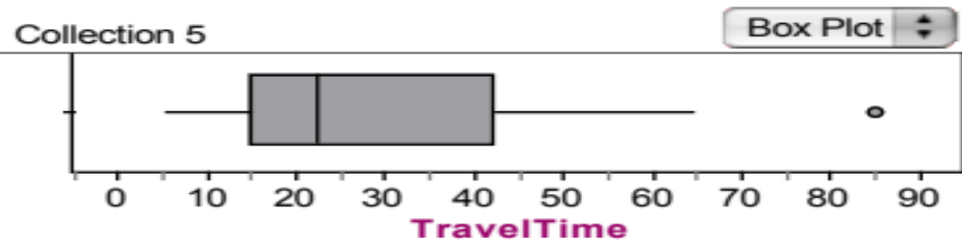
Boxplots and outliers
Consider our NY travel times data. Construct a boxplot.
10 | 30 | 5 | 25 | 40 | 20 | 10 | 15 | 30 | 20 | 15 | 20 | 85 | 15 | 65 | 15 | 60 | 60 | 40 | 45
5 | 10 | 10 | 15 | 15 | 15 | 15 | 20 | 20 | 20 | 25 | 30 | 30 | 40 | 40 | 45 | 60 | 60 | 65 | 85
Min=5
Q₁ = 15
M = 22.5
Q₃= 42.5
Max=85
This is an outlier by the
1.5 x IQR rule

Slide 50
Thank you

